Slide 1
Do Now
Convert the following to scientific notation:
3,400 2,000,000
0.000043 0.000980
120.01 120.00

Slide 2
This week in Chemistry Class
Monday-Continue Ch. 1&2. Conservation mass lab.
Tuesday-Finish Ch. 1-3.
Wednesday-Separation of a mixture lab. Bring in magnets please.

Slide 3
This Week Continued
Thursday-Finish Separation of a Mixture lab. Review for quiz on Ch. 1-3.
Friday-Quiz on chapters 1-3.

Slide 4
Due Date Change!!!
I hope to have chapters 1&2 finished on Monday.
Plan to be finished all of Ch. 1&2 by Tuesday. I may be checking it. I will cover all of Ch. 3 on Tuesday.
You will hand in all of Ch. 1-3 questions Wednesday.

Slide 5
Objectives for Monday
Students will…
  Describe elements of the periodic table of elements (PTE) using chemical symbols.
  Explore the conservation of mass.
  Evaluate the densities of different materials.

Slide 6
Pure and Applied Chemistry
Pure Chemistry-Learning for the sake of learning.
Applied Chemistry-Learning for the sake of solving real-world problems.

Slide 7
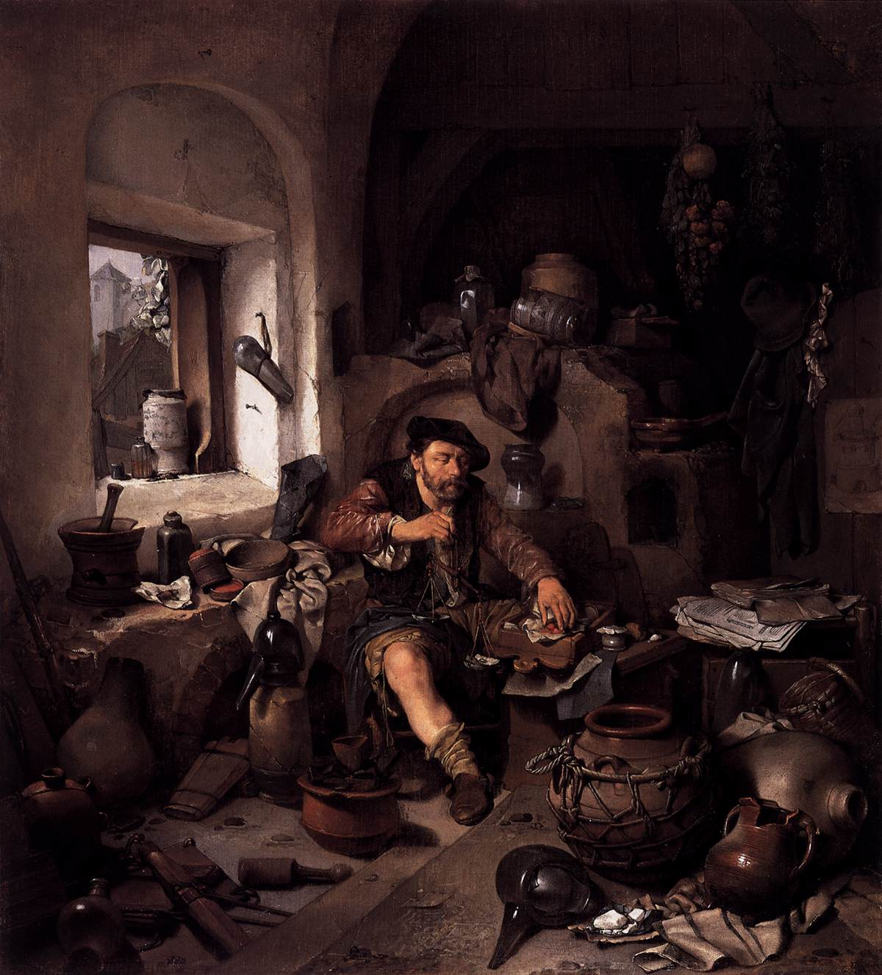
Alchemy
-The search for noble materials.
-Developed many of the tolls and techniques we use in modern chemsitry.

Slide 8

The Deadly Irony of Gun Powder

Slide 9
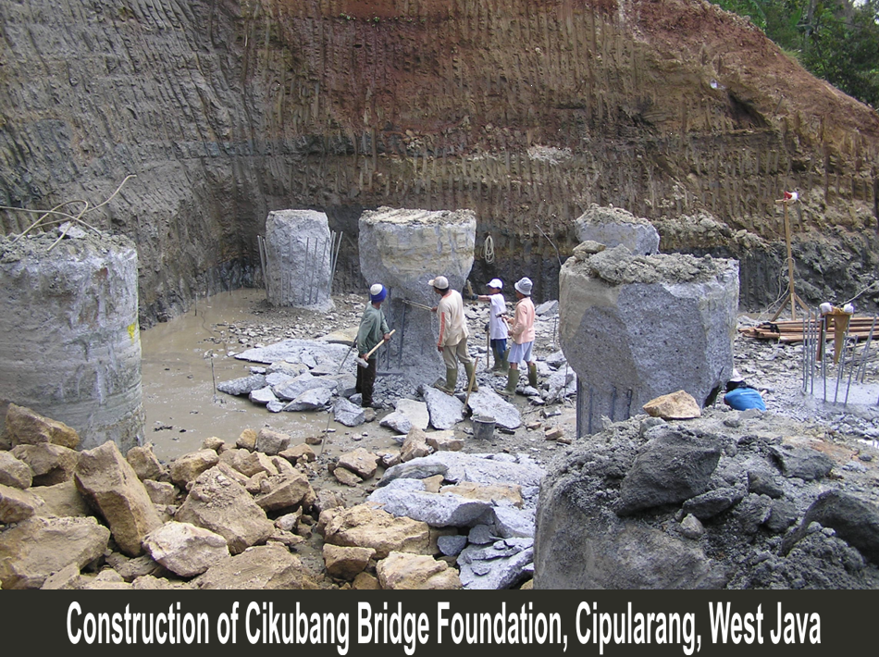
Engineering
the application of scientific, economic, social, and practical knowledge in order to invent, design, build, maintain, and improve structures, machines, devices, systems, materials and processes.

Slide 10

What does that sound like to you?

Slide 11
Density
What’s the formula for density?
Units?
What’s the density of water?
How did you find this?

Slide 12
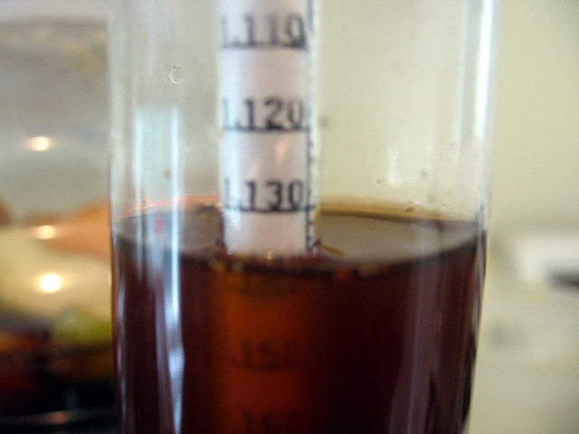
Specific Gravity
The density of a liquid, relative to water.

Slide 13
Specific Gravity
We know the density of water.
Water has a specific gravity of 1.
A liquid that has a specific gravity of 2 has a density of 2g/ml.
If a liquid has a specific gravity of 1.13, what is the density of the liquid?

Slide 14
Chemistry and Society
Chemists design materials for specific jobs.
What are some materials that would be bad for a particular job? Why?
What would be a better material?
Ex-Stirring stew with a solid iron ladle. Use wood instead.

Slide 15
The Chemistry of Energy
Two of the four “great forces” are contained in chemical compounds.
The “strong” and “weak” forces in chemicals make them great for energy transfer and concervation.

Slide 16
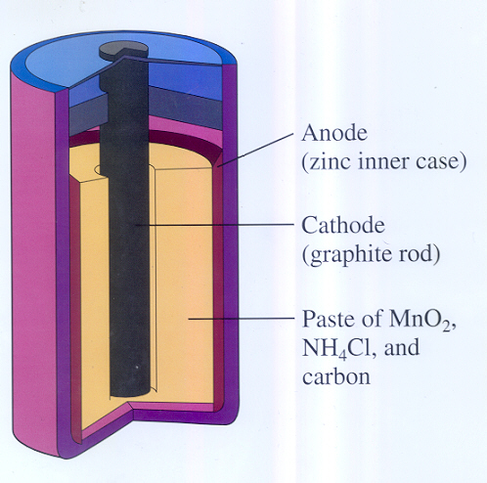
Batteries
When you complete the circuit electricity comes out.
Why?

Slide 17
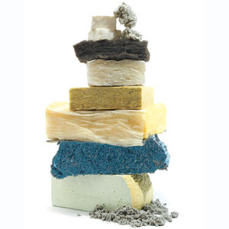
Insulation
While some materials are good for transferring energy, others are really bad at it. How is this useful?

Slide 18
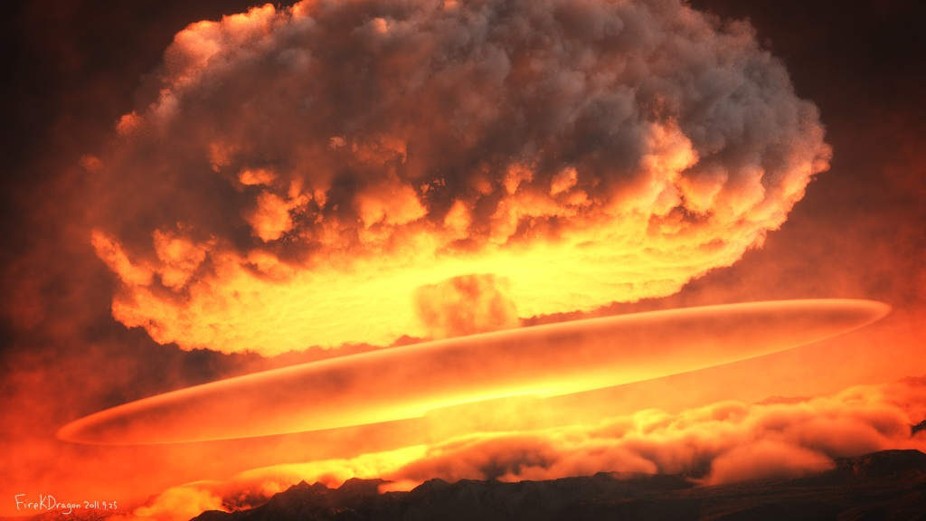
Energy Production
Breaking apart chemical bonds releases energy. What are some ways that we harness this energy?

Slide 19
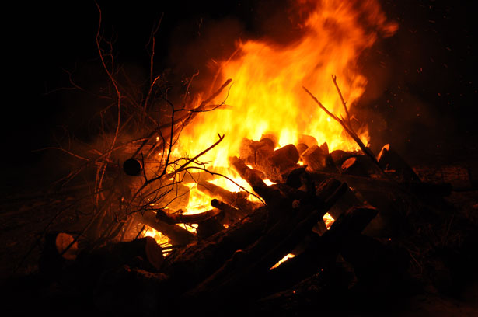
Breaking the Weak Force

Slide 20
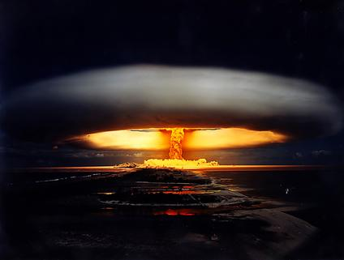
Breaking the Strong Force

Slide 21
Chemistry and Medicine
Chemists have helped to advance medicine on so many levels.
Developing materials for diagnostic testing.
Medication developments.
Technology advances.

Slide 22
Chemistry and Society
What sorts positive affects has chemistry had on agriculture?
On ecology?

Slide 23
Answer the Following
If you had to describe the scientific method to a 3rd grader, what would you say?
Why do people not trust science sometimes?
Why is science important to society?

Slide 24

The Dangers of Science Denial

Slide 25
Scientific Theory
Scientific theory is not simply an opinion.
Scientific theories are well-tested explanation for a broad set of observations.
A “law” has an explicit cause and effect. Many times it is accompanied by an equation.

Slide 26
Conservation of Energy Lab
Once you have a copy of the lab, read over the background information.
This is a VERY IMPORTANT concept that you should WRITE DOWN IN YOUR NOTES.
I will go over the chemical equation.

Slide 27
Safety First
Goggles must be warn at all times.
We will be mixing glass inside of glass.
Know what to do if there is an accident.
Make sure that whenever you measure the mass of the bottle that you have the CAP on it.

